Slide 1
CS 341 Lab 4
Fall 2020

Slide 2
Lab 4
Goal: investigate memory mapped I/O
Determine which bits in memory control pin 13
Blink an LED (as we did in lab 1) but without using digitalWrite()

Slide 3
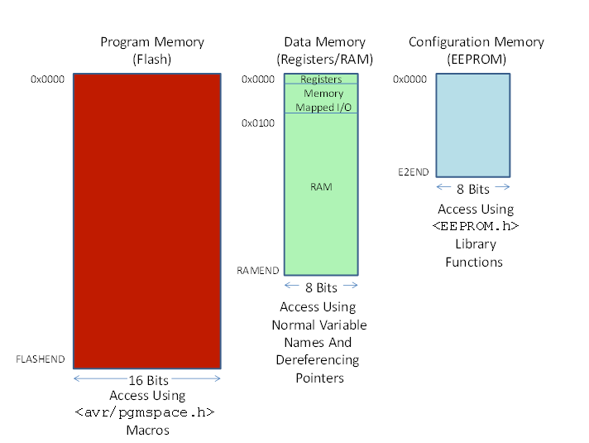

Slide 4
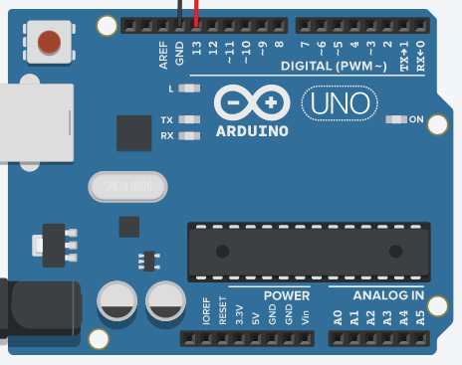
Memory Mapped I/O
There is a little bit of space allocated for each of the pins on the Arduino
We can access this memory without any special functions such as in() and out()
Pins

Slide 5
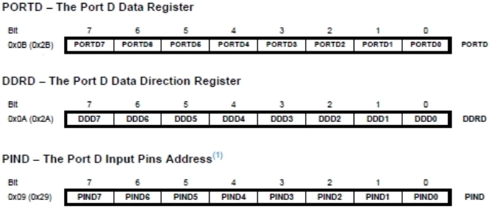
Organization of Pins
Digital Pin 3’s Bits
bits are organized by purpose, not by pin
Data Register – where we write to
Data Direction Register – 0 for reading, 1 for writing
Input Pins – where we read from

Slide 6
Example
How can we access PIND5?
Create a pointer to address 0x29
dereference it
Shift 5 bits to the right
Use a bitmask to see only PIND5
char *example = (char *) 0x29;
int theBit = (*example >> 5) & 1;
Serial.println(theBit, BIN);
// will return 1 or 0

Slide 7
Interfacing with a digital pin
Using provided functions
Directly using memory addresses
pinMode(int pin, OUTPUT);
pinMode(int pin, INPUT);
digitalWrite(int pin, HIGH);
digitalWrite(int pin, LOW);
digitalRead(int pin);
Set data direction bit to 1
Set data direction bit to 0
Set data bit to 1
Set data bit to 0
Check value of input bit

Slide 8


Blinking the LED manually
Let’s say that the address for writing to pin 7 is 0x50 and the correct bit is the 6th bit
0100 0000₂
Then, this code sets pin 7 to HIGH
And this code turns pin 7 on and off for 1 second each

Slide 9
Provided Functions
void displayRAM(char *start, char *endd, bool hex)
Same as we saw in lab 2
Example output:
020: 00 00 00 00 20 00 00 00 00 01 00 00 00 00 00 00
void displayBits(char *address)
Prints an address in hex
Example output:
0x100: 1001111

